Slide 1
Multi-component Systems
Phase Diagrams - Lectures 28/29
Learning Objectives
- phase diagram basics
- navigating around phase diagrams
- basic quantitative calculations from p.d.’s
- understanding of more complex structure
formation predicted by phase diagrams

Slide 2
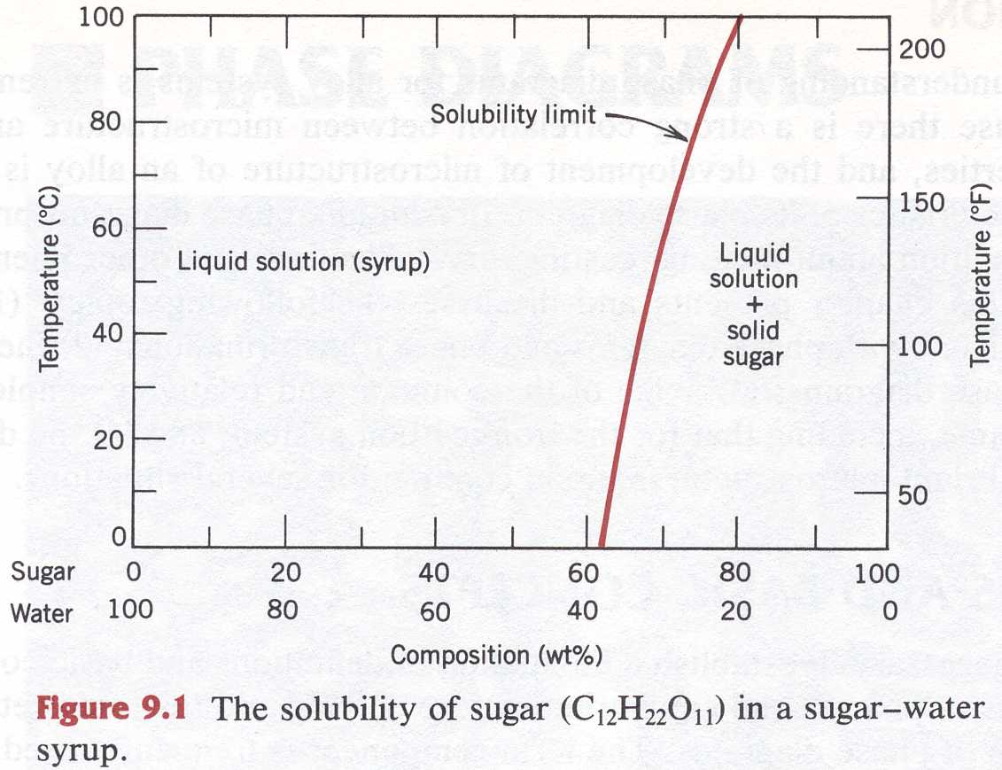
Phase Diagrams
Callister Ch. 10
Phase Stability Diagrams
  Stable Phases
    Solubility Limit
Callister Fig. 9.1

Slide 3
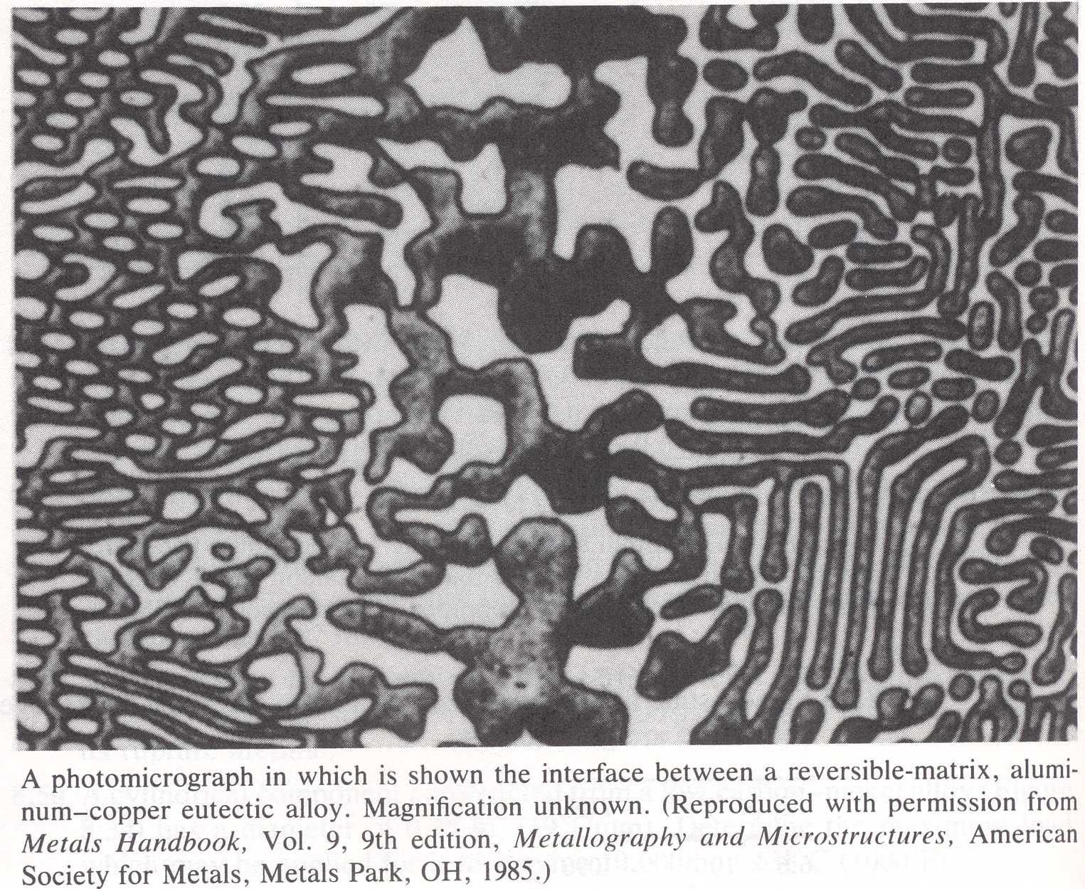
Phase Diagrams
Two-component systems: phases with two different compositions can coexist at equilibrium
Affects the
Physical Properties
of a material
Mechanical
Thermal
Electrical
etc.
Example:
Al – Cu Alloy
(Callister 3rd Ed.)

Slide 4
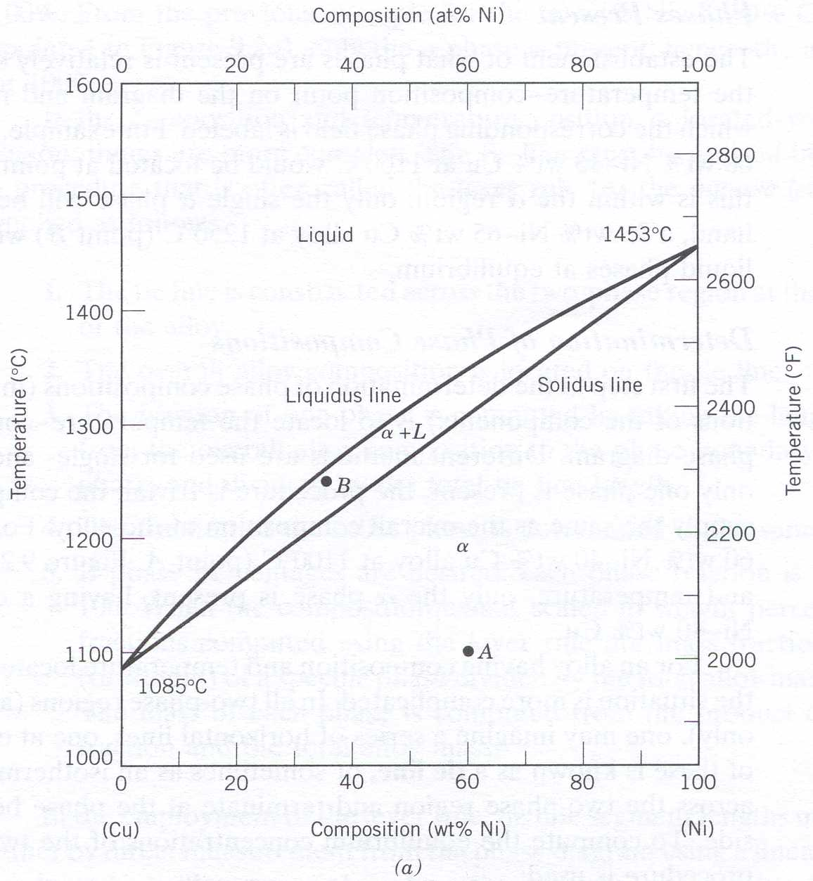
Phase Diagrams
9.6 Binary continuous solid solutions
  E.g., Cu – Ni, Si – Ge, Al₂O₃ – Cr₂O₃
    Two constituents
    The same structure for each constituent (e.g., fcc)
    Solid Phase: Range for Complete Solid Solution
      Atomic radius ratio close to unity
    Different Melting Temperatures
    Liquid Phase: Range for Complete Solid Solution
    Region of Liquid and Solid Phase coexistence separation
Callister Fig. 9.2 a

Slide 5
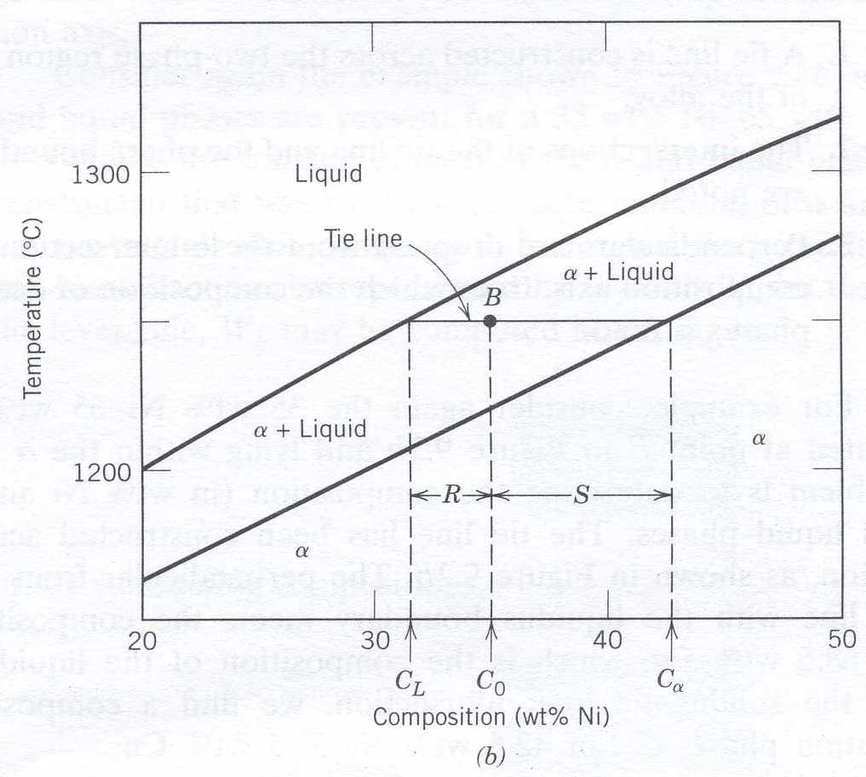
Phase Diagrams
9.6 Binary continuous solid solutions
  Solidus
    Line identifying concentration of the SOLID in equilibrium with the liquid
  Liquidus
    Line identifying concentration of the LIQUID in equilibrium with the solid
  Tie Line
    Line connecting the Solidus and Liquidus at a given Temperature
Callister Fig. 9.2 b

Slide 6
Tie lines & the lever rule
9.6 Interpretation
  Phases Present (L + S)
  The Compositions of the Phases that are Present (C_{L} + C_{α})
  The Fractions of each of the Phases Present
    Weight Fraction
    Volume Fraction
    Molar (or Atomic) Fraction
Callister Fig. 9.2 a
T
L
S

Slide 7
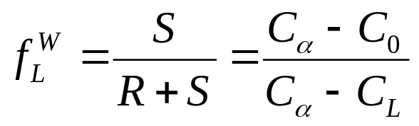
Lever rule
9.6 Fractions of Phases Present
  Note: Diagram in wt%
    Liquid Phase C_{L}
    Solid Phase C_{α}
  Lever Rule (or Inverse Lever Rule)
    Account for all the atoms of the system
  Initial Composition C₀
  Weight Fraction Liquid:
Callister Fig. 9.2 a
T

Slide 8
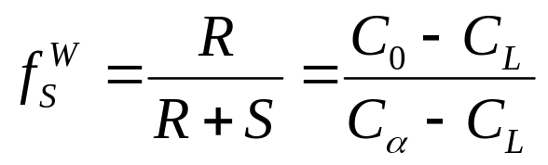
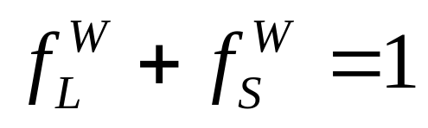
Lever rule
9.6 Fractions of Phases
  Fraction Liquid:
  Fraction Solid:
  Conservation of Mass
Callister Fig. 9.2 a
T

Slide 9
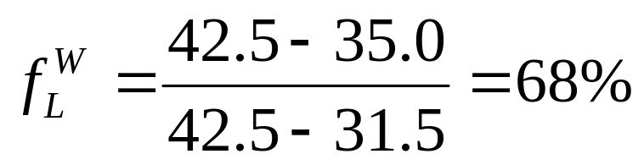
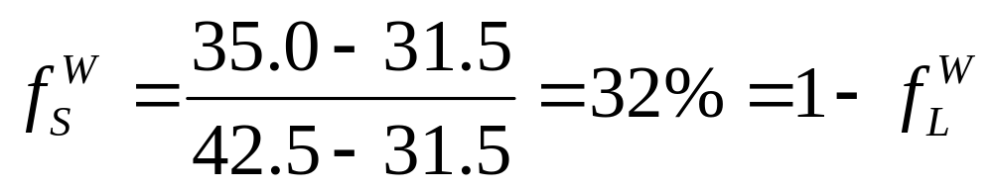
Phase Diagrams
Example Problem 9.1
  T= 1250ºC
    C₀ = 35.0 wt%
    C_{L} = 31.5 wt%
    C_{α} = 42.5 wt%
  Fraction Liquid:
  Fraction Solid:
Callister Fig. 9.2 a
T=1250ºC

Slide 10
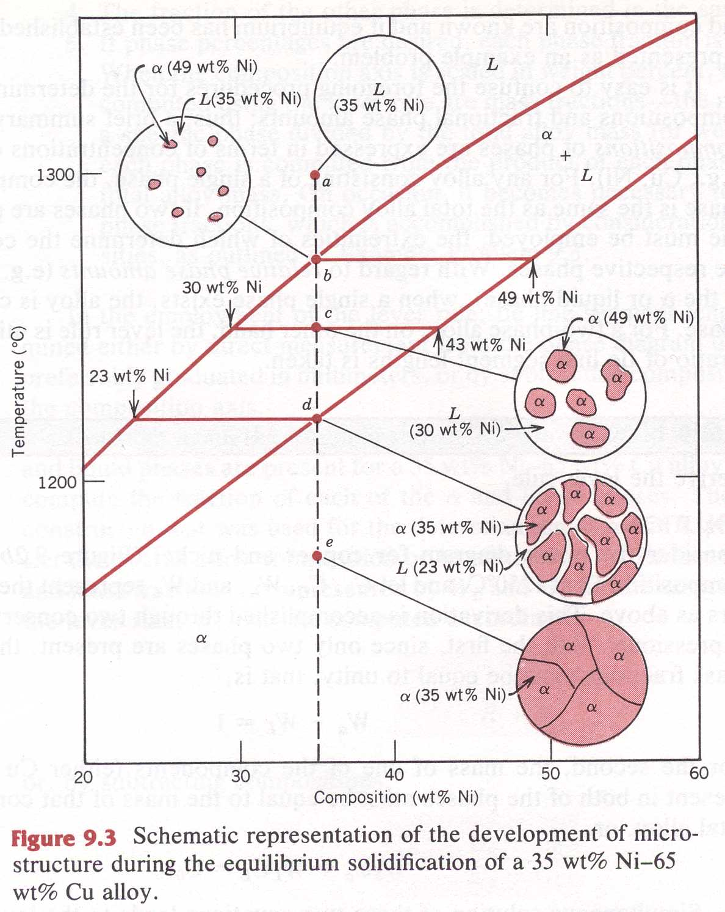
Phase Diagrams
Microstructure Evolution – Assume Equilibrium Cooling
  Liquid Phase
  Nucleation of Solid
  Growth of Solid in the liquid
  Disappearance of Liquid
  Solid Phase

